Slide 1
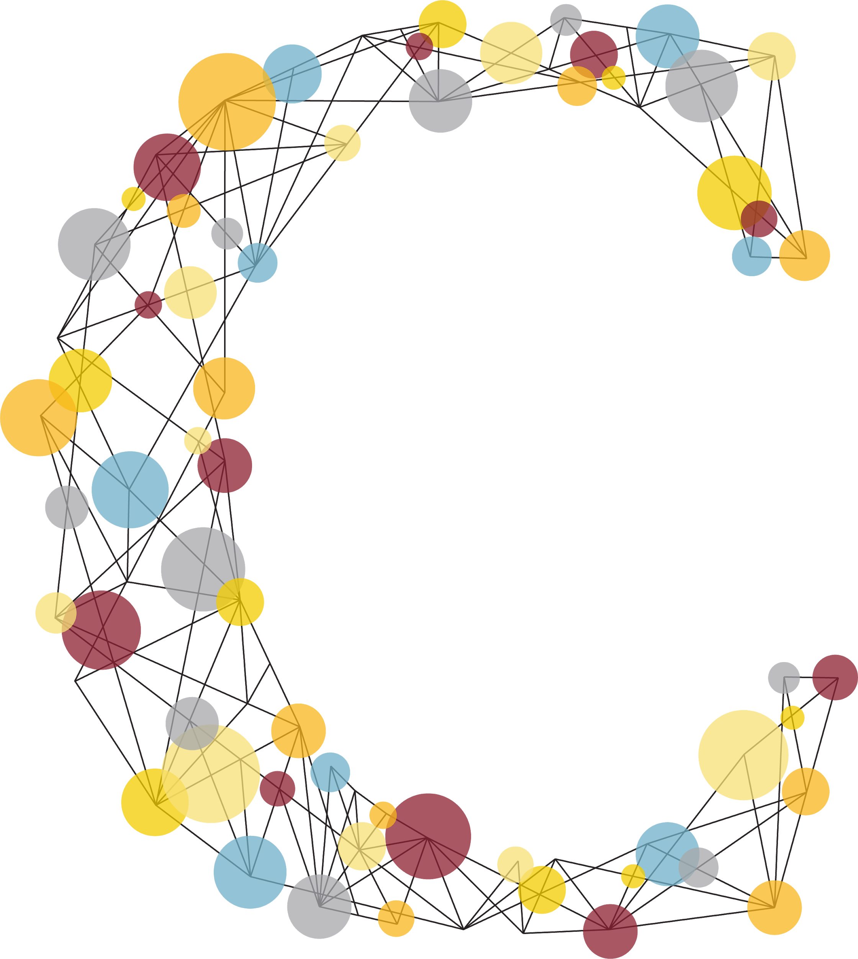
Calvin Connect
Alvin Chung, Emma Chung, Cora Jung, Juli Lim, Enoch Mwesigwa, and Sam Zeleke

Slide 2
VISION

Slide 3
DESIGN

Slide 4



STUDENTS
ALUMNI
FACULTY/DEPT

Slide 5
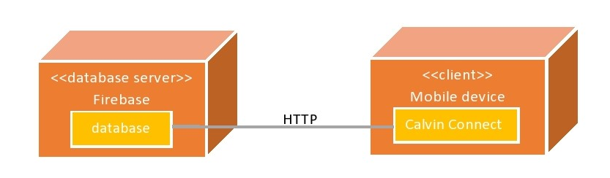
DEPLOYMENT
DIAGRAM

Slide 6
CHANGES
Navigation Tab
News Feed Design
Consistency
Profile Icon
Setting layout

Slide 7
DEMONSTRATION

Slide 8
PROFILE

Slide 9
MENTORSHIP

Slide 10
SETTINGS

Slide 11
CHAT

Slide 12
SEARCH

Slide 13
ASSESSMENT

Slide 14
STRENGTHS
Our Idea
Safer Environment
App Design

Slide 15
WEAKNESSES
Functional
Database Queries Lags
Chat
Database Storage
Notes:
Finding user base - we have to reach out for app usage, instead of them coming to us

Slide 16
non-
WEAKNESSES
Functional
User Base
Financial sustainability
Notes:
Finding user base - we have to reach out for app usage, instead of them coming to us

Slide 17
FUTURE PLAN
Enhance Chat & Search
Events
Donation
Expand Database Storage
More Usability Tests

Slide 18
FUTURE PLAN
Promotion
Eject to Native Code

Slide 19
FUNCTIONALITY
Pages are Mostly Working
But Some Bugs...

Slide 20
SOCIETAL/ETHICAL
Strong Bridge between
Calvin Students & Alumni
For Growth of Calvin Community

Slide 21
FUTURE PROSPECTS
Existing App
Competition with Other Big Apps

Slide 22
QUESTIONS?

